Slide 1
Sensor Fusion-based Emotion Classification In Virtual Reality Using Machine Learning
@NCSP22
Yi Liu, Eri Sato-shimokawara
and Toru Yamaguchi
Tokyo Metropolitan University
Yamaguchi Lab
Notes:
Good morning,everyone.
Let me introduce myself first.
I am LIUYI from Tokyo Metropolitan Unviersity ,Yamaguchi Lab
Today,My presentation title is <Sensor Fusion-based Emotion Classifcation In Virtual Reality Using Machine Learning>.

Slide 2



Section1- Intorduction
In recent years
The development of virtual reality technology
has made VR content available to the average household
———————————————————————————————————
To help conversation on those online virtual world platforms
Estimate users’ inner moods and evaluate dialogue atmosphere
based on affective computing methodology
Notes:
In recent years
The development of virtual reality technology has made VR content available to the average household
To help conversation on those online virtual world platforms
We need to Estimate users’inner moods and evaluate dialogue atmosphere

Slide 3

Section1- Intorduction
However
Emotions are sometimes not expressed
And information expressed,
such as facial expressions and voices,
can differ from the actual emotion[1]
For example
People can fake a smile when
feeling sad or angry inside
Notes:
However
Emotions are sometimes not expressed
And information expressed,
such as facial expressions and voices,
can differ from the actual emotion[1]
For example
People can fake a smile when
feeling sad or angry inside

Slide 4

Section1- Intorduction
Based on this understanding
Our research aims to understand true feelings toward estimating group-level atmosphere in multi-person Dialogues while immersed in the VR world
In this study
We used biological features extracted
from EEG and ECG
to classify basic emotion
We used biological features and
audio features
to classify dialogue atmosphere
and basic emotion

Slide 5
Section1- Structure of this presentation
Section 1, Introduction
Section 2, Background and related work
Section 3, The first experiment and evaluation;
Section 4, The second experiment and evaluation;
Section 5, Conclusion and future work recommendation.
Notes:
The Structure of this presentation is shown as below.
In section 1, we had made a brief introdcution on our study
In section 2, the background and related work for this research paper will be briefed;
In section 3 and section 4 we will propose the first and the second experiment and evaluation;
In section 5, we will present the conclusion and future work recommendation.

Slide 6

Section 2 - Related Work
Automatic Emotion Recognition
→biological information,
→External features
→environement, etc.
In Yuhei Ikeda's research
Brain waves and heart rate were uesd for Estimating Emotion for
Robot Interaction[1]
In Marín-Morales's research
They researched emotion recognition from brain and heartbeat
dynamics using wearable sensors in virtual reality[3].
In NS Suhaimi’s research
They did Emotion state classification of EEG brain signal using
SVM and KNN[4]
Notes:
Related Work For Automatic Emotion Recognition
we usually use biological information ,human External features and sometiems environement data
a lot of researches had been conducted in Human robot interaction
..and the AEE researches in VR are also popular.
In Marín-Morales's research, they use brain and heartbeat dynamics for emotion recognition in VR
In NS Suhaimi’s research,They did Emotion state classification of EEG brain signal using SVM and KNN

Slide 7
Section 2 - Related Work
Mood Enginnering[5]
→"Atmosphere"
→Proposed by the Japanese Society for Artificial Intelligence(JSAI) in 2013.
DNP(Dai Nippon Printing Co., Ltd.)——"next-generation stealth space"
Change the color of light and music in a room by using sensors to detect the status of people’s presence and conversations and the indoor environment.
In Shohei Kato's research
They researched Dialogue Mood Estimation Focusing on Intervals of Utterance State[6]
Use Speech Sounds considering Personality Trait of Speaker for Dialogue Mood Estimation[7]
Notes:
Mood Enginnering,which is proposed by JSAI, is a thoery to study “atmosphere”
DNP had developed a smart room that can change light and music according to the indoor atmosphere
In Shohei Kato's research
they use utterance features to estimate dialogue atmosphere

Slide 8
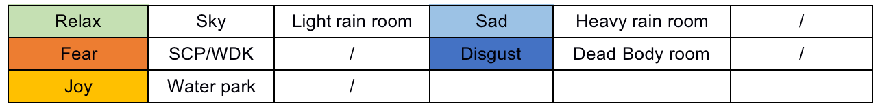
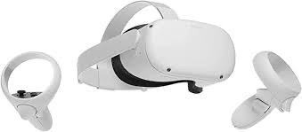


Section 3 - Preliminary Experiment
APP: VRChat
Participants: 10 participants aged between 20 and 28
Used Features: EEG,Accelerator(Muse2 headband), HRV<-ECG(Polar H10)
Worlds: Six worlds for arousing different emotions in VRChat.
Each world for about three minutes.
Notes:
(4M45)
My first experiment was conducted in VRChat
10 participants were recruited to experience Six virtual worlds in VRCHat
The EEG and ECG will be recorded, we use EEG,accelerator and HRV extracted from ECG as features.
and every section will last for about 3 minutes.We use the data of last minute.

Slide 9
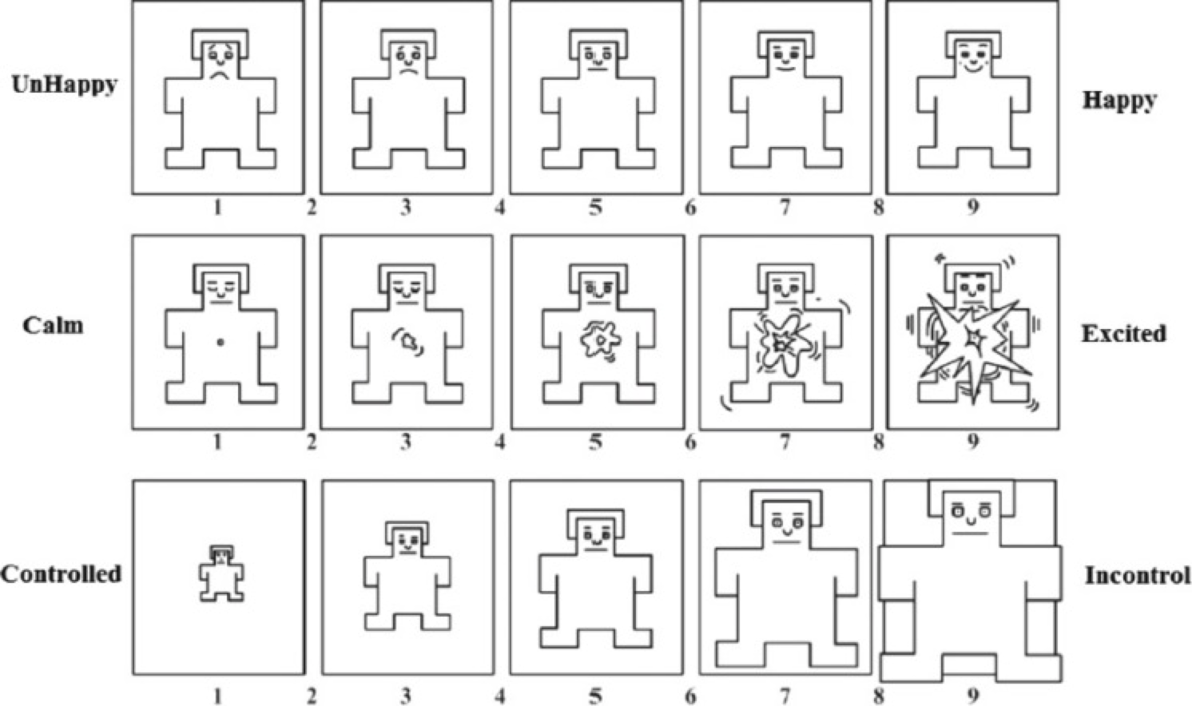
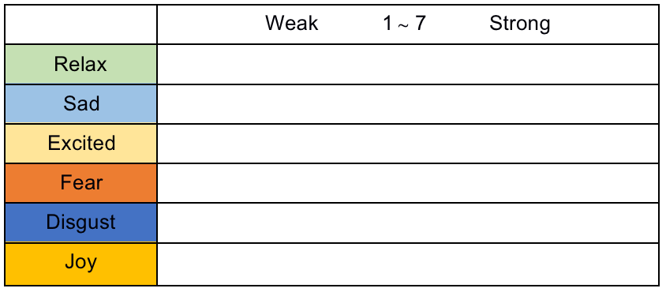
Section 3 - Preliminary Experiment
Questionnaire: SAM questionnaire[8], Six emotions questionnaire
Valence
Confirm the effectiveness of VRChat worlds to arouse emotion
Better understand participants' mood state
Help participants better self-report
Arousal
Dominance
Basic Emotion
Level
Notes:
After each section, they need to answer SAM questionnaire and six emotions questionnaire
SAM questionnaire can be used to self-report participants' Valence,Arousal and Dominance level,
and Six emotions quesitonnaire is used to evaluate participants' basic emotion level
By these two questionnaire，we can
（1）Confirm the effectiveness of VRChat worlds to arouse emotion、
（2）Better understand participants' mood state during the experiment
（3）Help participants better self-report their emotions

Slide 10
Section 3 - Preliminary Experiment
Self-report Result（Average）：
The emotional arousal experiment in VRChat can effectively arouse collaborators’ emotions.
There are situations where collaborators are happy&relaxed(Fear&Disgust, Excited&Joy) simultaneously
→Those emotions are not discrete in some cases.
 | Valence | Arousal | Dominance | Emotion Value
Relax1 | 5.25 | 1.75 | 6.125 | 5.56 Relax
Relax2 | 4 | 1.75 | 5.5 | 6.0 Relax
Sad | 2 | 3.75 | 2.875 | 5.25 Sad
Fear | 1.875 | 6.25 | 1.5 | 6.0 Fear
Disgust | 2.5 | 5.375 | 3.25 | 6.0 Disgust
Joy | 7.14 | 3.71 | 5.86 | 5.86 Joy
Notes:
Accoding to the self-report result ,the emotional arousal experiment in VRChat can effectively arouse collaborators emotions.
We also found there are situations where collaborators are happy&relaxed(Fear&Disgust, Excited&Joy) at the same time.
It suggests that those emotions are not discrete in some cases.

Slide 11
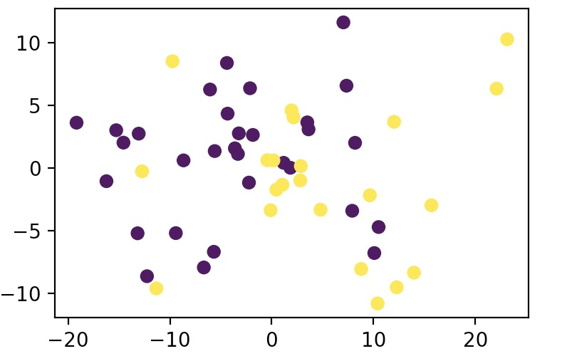
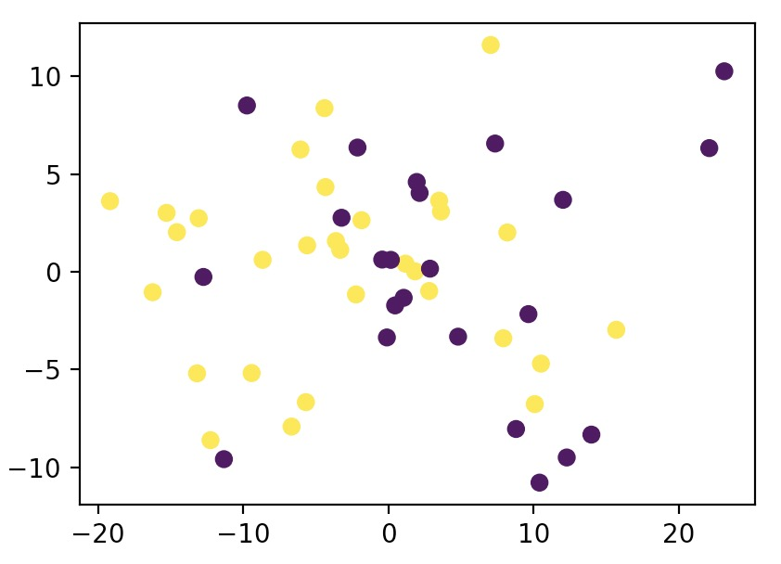
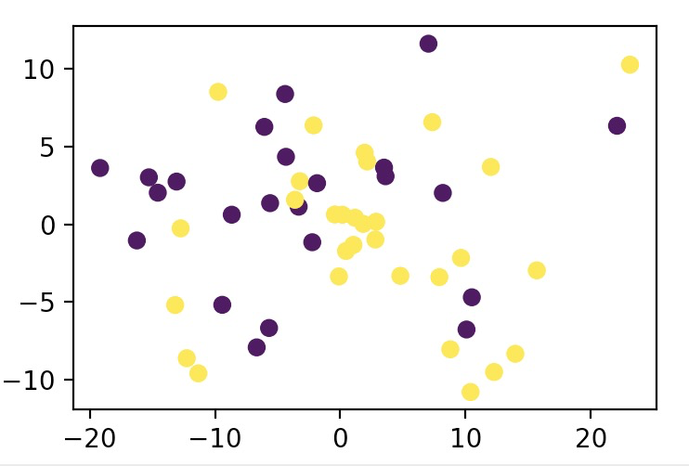
Section 3 - Preliminary Experiment
Data Processing
Relax
Fear
Joy
PCA Scatter plot(2 dimensions) ↑ for Relax, Fear and Joy
We mapped the self-report results to two categories → True and False
Remove obvious Outliers
Use undersampling and oversampling to balance the samples
After normalization, PCA (reduction to 20 dimensions), one-hot encoding,
we trained Machine Learning Model for classification

Slide 12
Section 3 - Preliminary Experiment
Cross-Validation Basic Emotion Classification Result：
After pre-processing, we trained SVM, Naive Bayes and KNN for emotion classification
 | SVM | Naive Baiyes | KNN
Relax | 0.6875±0.15 | 0.625±0.15 | 0.5625±0.15
Sad | 0.6875±0.15 | 0.625±0.15 | 0.625±0.15
Fear | 0.6875±0.07 | 0.625±0.07 | 0.6875±0.15
Disgust | 0.5625±0.15 | 0.625±0.15 | 0.5625±0.07
Joy | 0.625±0.15 | 0.5625±0.07 | 0.625±0.07
Limitation:
Poor contact problem of Muse2 Headband
VRChat has few suitable world that cause pure excite, so excite is not trained for classification.
Individual differences appear(not typical data)
Small amount of training data
Notes:
We trained SVM,Naive Bayes and KNN to classify emotion
Accoding to the result ,we know EEG and ECG can be used to classify emotion in VR
However, because of the poor contact problem of Muse2 brainwave headband, the EEG data collected are not very good
and we find individual differences appear in our experiment
what’s more ,the amount of training data is too small,we need to collect more data

Slide 13

Section 4 - Second Experiment
APP：Horizon Workrooms
Participants:
Six pairs of collaborators were recruited
Used Features：
HRV<-ECG(Polar H10),
audio features[9]<-noise-reduced WAV
<-MP3(Sony Recorder)
Details:
Two collaborators were sitting in separate quiet classrooms
They can not hear each other if they do not wear VR headset
Each conversation lasted approximately three minutes
Take a break between each topic and answer the questionnaire
Topic:
The topics they need to talk were chosen randomly,
likely to cause emotional fluctuations or produce opposing positions
Notes:
The second Experiment were conducted in Horizon Workrooms
SIx pairs of collaborators were recruited to talk in the virtual meeting room
We had abandoned Muse2, and only use ECG and audio data to classify dialogue atmosphere and emotion
We let two collaborators to sit in separate quiet classrooms
they can not hear each other if they do not wear VR headset
each conversation lasted approximately three minutes
take a break betwenn each topic and answer the questionnaire
they need to talk on a specific topic,and each conversation last about 3 minutes
The topics will be chosen randomly, and they are likely to cause emotional fluctuations or produce opposing positions

Slide 14
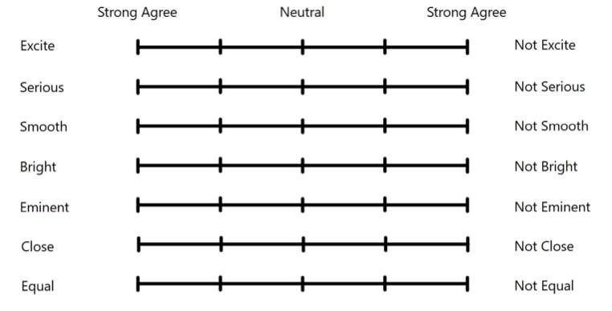
Section 4 - Second Experiment
Questionnaire: Dialogue Moods Questionnaire, Six emotions questionnaire
Despite two people being in the same conversational setting,
there may be opposite results in evaluating the dialogue atmosphere by both parties.
→For example:
One person may feel that the dialogue atmosphere is very Excite,
while another person may feel not
Notes:
This is the Dialogue Moods Questionnaire,beside this ,collaborators also need to answer the Six emotions questionnaire
We find Despite two people being in the same conversational setting,
there may be opposite results in evaluating the dialogue atmosphere by both parties.
For example:
one person may feel that the atmosphere is very Excite, while another person may feel not

Slide 15
Section 4 - Second Experiment
Cross-Validation Dialogue Mood Classification Result：
After normalization, PCA, one-hot encoding,
we trained SVM, Naive Bayes and KNN for dialogue mood classification.
 | SVM | Naive Baiyes | KNN
Excite | 0.730±0.12 | 0.672±0.12 | 0.656±0.12
Serious | 0.708±0.12 | 0.762±0.09 | 0.729±0.09
Smooth | 0.796±0.15 | 0.775±0.18 | 0.789±0.18
Bright | 0.712±0.15 | 0.726±0.18 | 0.683±0.18
Eminent | 0.694±0.18 | 0.677±0.18 | 0.622±0.16
Close | 0.688±0.12 | 0.689±0.16 | 0.638±0.22
Equal | 0.667±0.12 | 0.687±0.18 | 0.621±0.22
Smooth has better results,
while Eminent, Close and Equal have relatively poor classification results
Notes:
The Dialogue Mood cross-validation Classification Result
shows ECG and audio features can be used to classify Dialogue Mood
We find Smooth has better results
while Eminent, Close and Equal have relatively poor classification results

Slide 16
Section 4 - Second Experiment
Cross-validation Emotion Classification Result：
After pre-processing,
we trained SVM, Naive Bayes and KNN for emotion classification
 | SVM | Naive Baiyes | KNN
Relax | 0.684±0.12 | 0.648±0.22 | 0.614±0.16
Sadness | 0.694±0.12 | 0.675±0.18 | 0.576±0.26
Excited | 0.667±0.09 | 0.632±0.18 | 0.532±0.09
Fear | 0.714±0.22 | 0.739±0.25 | 0.634±0.18
Disgust | 0.578±0.25 | 0.643±0.25 | 0.611±0.22
Joy | 0.624±0.14 | 0.591±0.18 | 0.639±0.14
Due to insufficient samples, the classification results of Fear and Disgust have large fluctuations.
Notes:
We also did Emotion Classification
Due to insufficient samples, the classification results of Fear and Disgust have relatively large fluctuations.
We do not have much Disgust and fear samples.

Slide 17
Section 5 - Conclusions
Our Work:
This study uses machine learning algorithms like SVM, KNN, and Naive Bayes
to classify basic emotion and dialogue atmosphere in VR.
limitation of this study:
Individual differences appear in biological information,
which may relate to the surrounding environment and individual physique.
Lack of diversity sample(ex.Equal,Close,Fear and Disgust)
Poor Contact problem of Muse2 while wearing VR headset
Notes:
In conclusion
This study uses machine learning algorithms to classify basic emotion and dialogue atmosphere in VR.
limitations of this study:
First, individual differences appear in biological information,
which may relate to the surrounding environment and individual physique.
Lack of diversity sample in some cases
The third limitation is Poor Contact problem of Muse2

Slide 18

Section 5 - Conclusions
Futrue Work:
Increase the amount of experimental data, and try Deep Learning
Apply real-time atmosphere and emotion recognition AI to ubiquitous VR innovative spaces and VR virtual humans
Recognize the degree of confidence, interest, and psychological fluctuations in multi-person conversations or collaborations in VR.
We hope to create an intelligent virtual human
that can automatically identify users' inner
emotions and dialogue atmosphere！
Notes:
For Futrue Work recommendation: i think we can
Increase the amount of experimental data, and try Deep Learning
Apply real-time atmosphere and emotion recognition AI to ubiquitous VR innovative spaces and VR virtual humans
In the next stage ，we tend to recognize the degree of confidence, interest, and psychological fluctuations in multi-person conversations or collaborations in VR.

Slide 19
Reference
[1] Yuhei Ikeda, Ryota Horie, and Midori Sugaya. Estimating emotion with biological information for robot interaction. Procedia computer science, 112:1589–1600, 2017.
[2] Andrius Dzedzickis, Arturas Kaklauskas, and Vytautas Bucinskas. Human emotion recognition: Review of sensors and methods. Sensors, 20(3):592, 2020.
[3] Javier Mar´ın-Morales, Juan Luis Higuera-Trujillo,Alberto Greco, Jaime Guixeres, Carmen Llinares,Enzo Pasquale Scilingo, Mariano Alcaniz, and Gaetano Valenza. Affective computing in virtual reality: emotion recognition from brain and heartbeat dynamics using wearable sensors. Scientific reports, 8(1):1–15, 2018.
[4] NS Suhaimi, J Teo, and J Mountstephens. Emotional state classification in virtual reality using wearable electroencephalography. In IOP Conference Series: Materials Science and Engineering, volume 341, page 012016.IOP Publishing, 2018.
[5] Daisuke Katagami. Could we artificially create atmosphere? In The 27th Annual Conference of the Japanese Society for Artificial Intelligence(2013), page 2 pages. The Japanese Society for Artificial Intelligence, 2013.
[6] Kaoru Toyoda, Yoshihiro Miyakoshi, Ryosuke Yamanishi, and Shohei Kato. Dialogue mood estimation focusing on intervals of utterance state. Transactions of the Japanese Society for Artificial Intelligence, 27(2), 2012.
[7] Tatsuya Hasegawa and Shohei Kato. Dialogue mood estimation from speech sounds clusterized with speakers’ personality traits. In 2019 IEEE 8th Global Conference on Consumer Electronics (GCCE), pages 399–401.IEEE, 2019.
[8] Margaret M Bradley and Peter J Lang. Measuring emotion: the self-assessment manikin and the semantic differential. Journal of behavior therapy and experimental psychiatry, 25(1):49–59, 1994.
[9] Theodoros Giannakopoulos. pyaudioanalysis: An opensource python library for audio signal analysis. PloS one,10(12):e0144610, 2015.
Notes:
this is my references

Slide 20
Acknowledgment
Thank you for your kind attention
ご清聴ありがとうございます
Notes:
I'd like to thank you for taking time out to listen to my presentation.

